Slide 1
Transfer Functions
Compiled By:
Asst. Prof. Uddhav Bhattarai
Cosmos College of Management and Technology

Slide 2
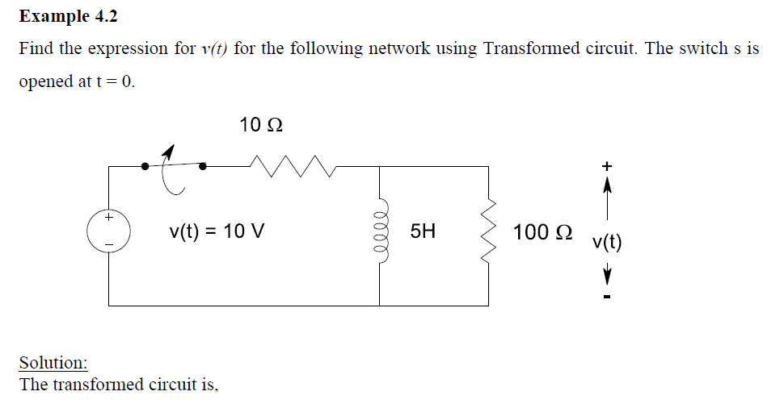
Transfer Functions

Slide 3
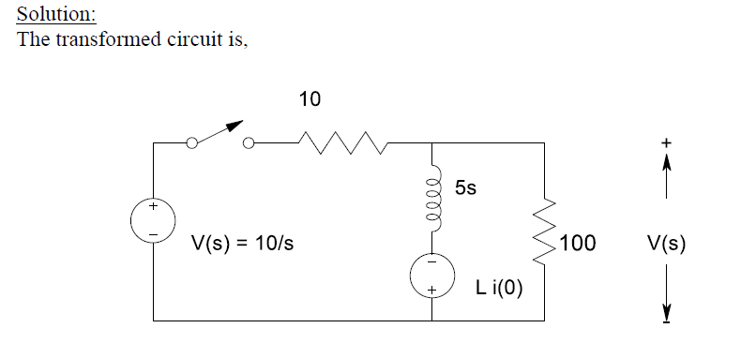
Transfer Functions

Slide 4
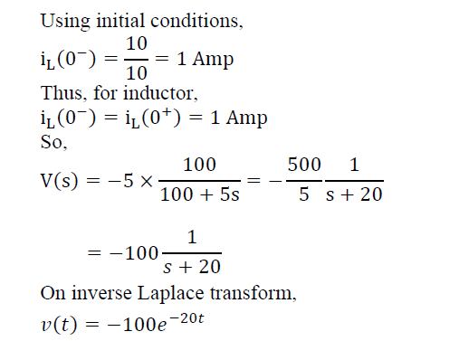
Transfer Functions

Slide 5
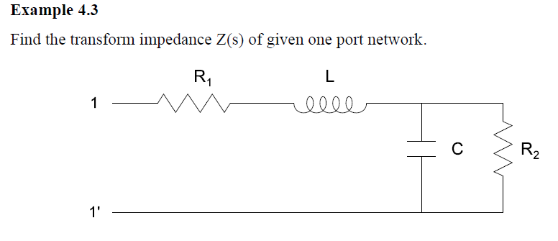
Transfer Functions

Slide 6
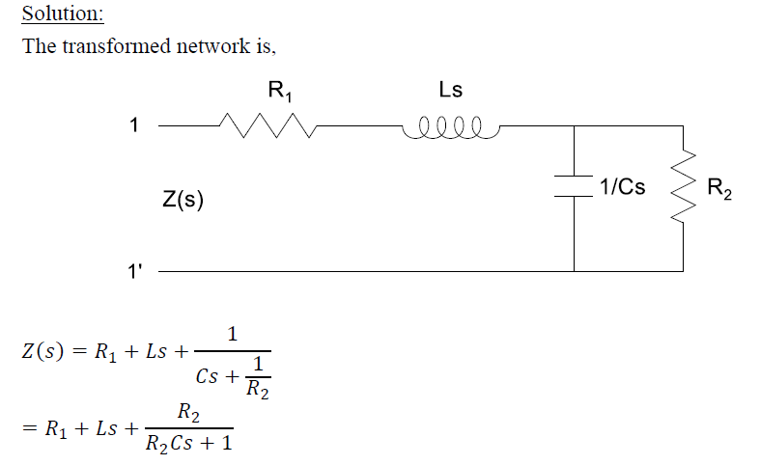
Transfer Functions

Slide 7
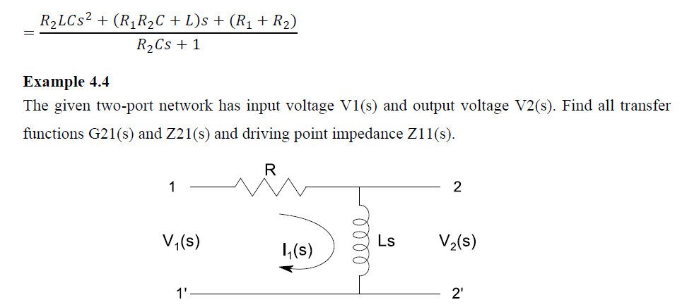
Transfer Functions

Slide 8
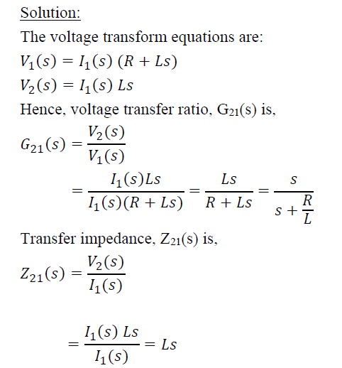
Transfer Functions

Slide 9
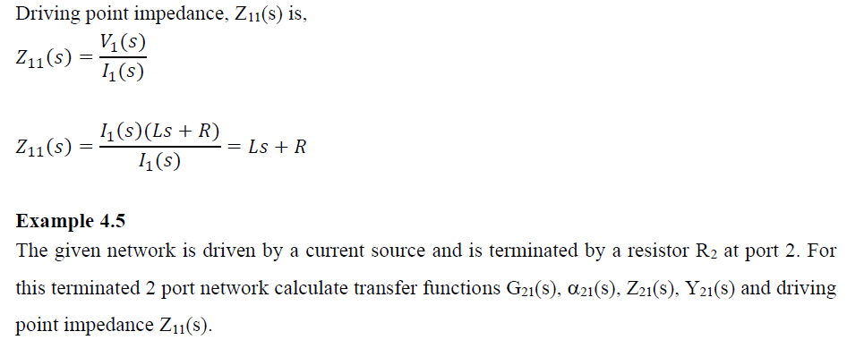
Transfer Functions

Slide 10
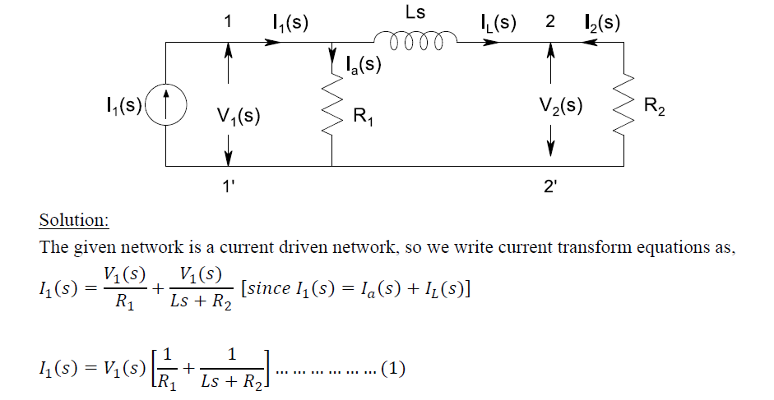
Transfer Functions

Slide 11
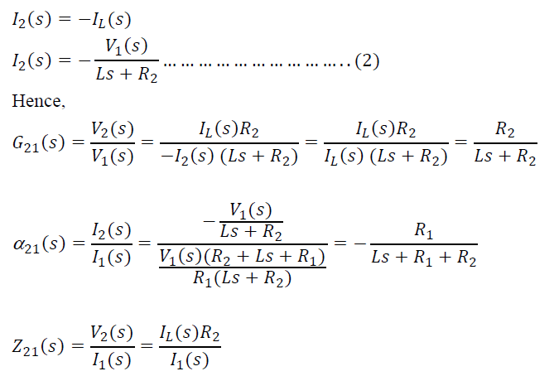
Transfer Functions

Slide 12
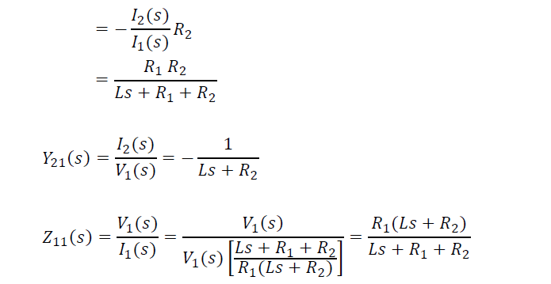
Transfer Functions

Slide 13
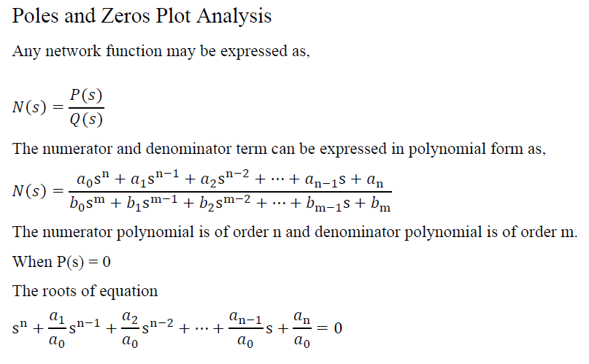
Transfer Functions

Slide 14
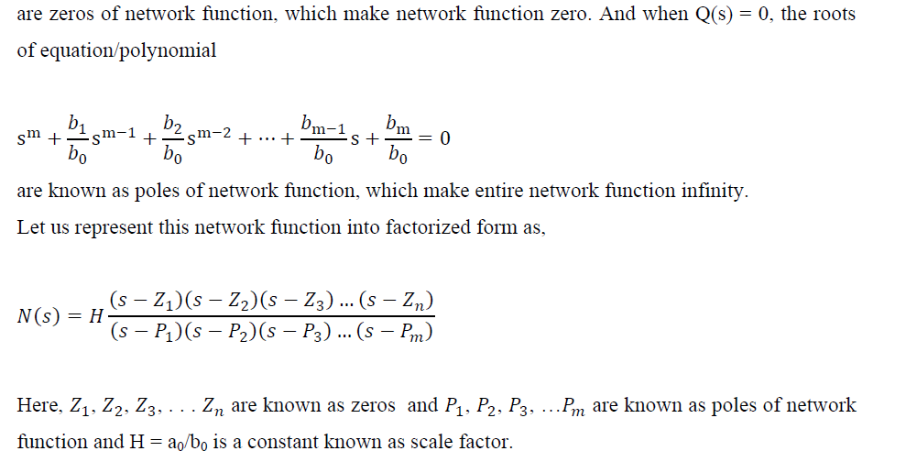
Transfer Functions

Slide 15
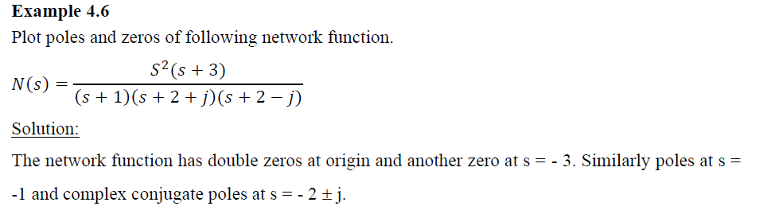
Transfer Functions

Slide 16
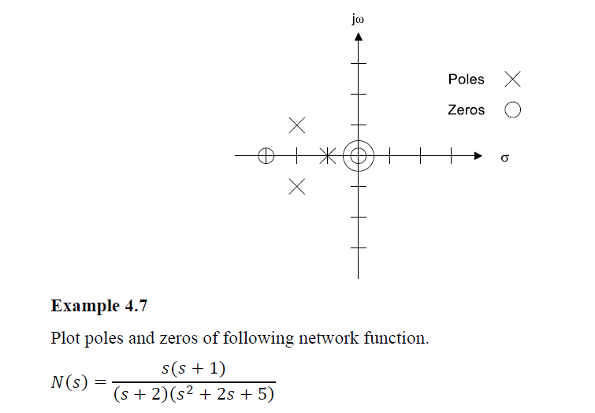
Transfer Functions

Slide 17
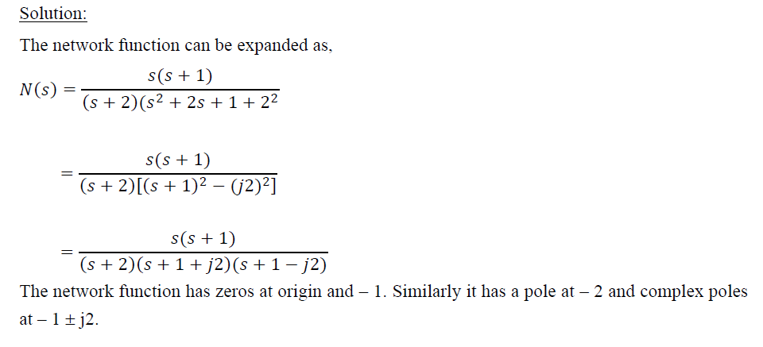
Transfer Functions

Slide 18
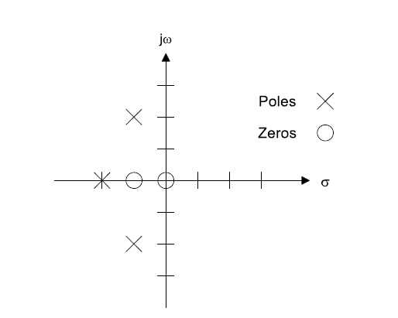
Transfer Functions

Slide 19
Transfer Functions
NEXT Class……………………..

